Slide 1
Screen setting instruction

Slide 2
Open “Displays” under “Settings”
Set Resolution “default”)
Uncheck automatic brightness
Uncheck Ture Tone
Make sure brightness is at the max (you will need to check this again before starting exp)

Slide 3
Go to ”Color” tab
Hold “Opinion” and click “Calibrate” – this turns on expert options

Slide 4
Continue with expert mode on

Slide 5
There will be several screens like this. I tried this two different ways, and the luminance looks more linear if I don’t mess with anything here.

Slide 6
Key step. Move the slider all the way to the left (to linear gamma)
On the next step, don’t mess with the white point
And the next step, don’t worry about allowing other users to use this calibration

Slide 7
Name the profile
This will now be the color profile that is selected automatically.
Your screen is now ready
When done you can go back to your original profile, and check boxes that were previously checked (the first slide on this instruction PPT)

Slide 8
Experiment instruction

Slide 9
Code files & data:
There are two code files: waldo_code_stroop_LAPTOP.m and waldo_code_stroop_LAPTOP_practice.m
Use your initial as the subject ID (change it around Line 24)
Run the ~practice.m first which has 30 trials, and then run the other code for real experiment, which has 300 trials in 1 block.
Practice + Experiment together should take you <10mins to complete.
After the experiment, please check the data folder: Waldo_Stroop_Data, to see if your data files are there
Practice data mat name: xx_practice_data.mat
Experiment data mat name: xx_waldo_data.mat

Slide 10

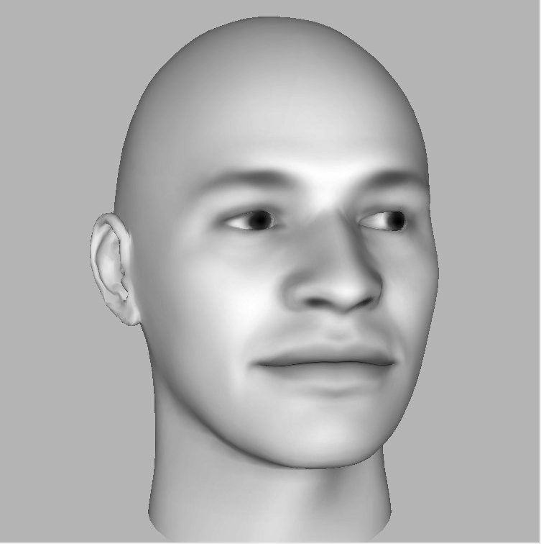
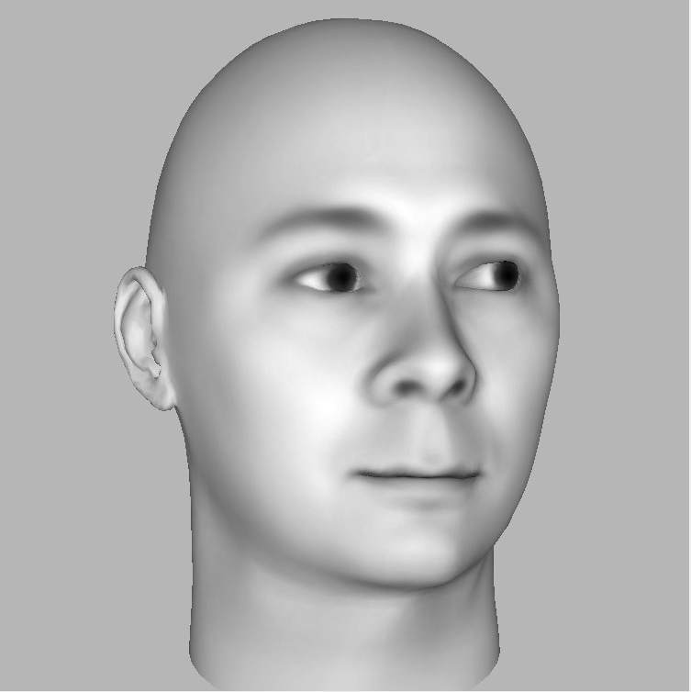
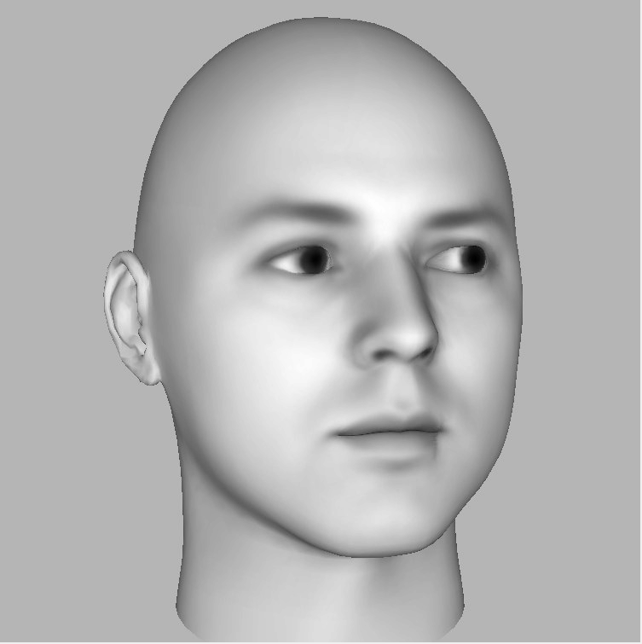
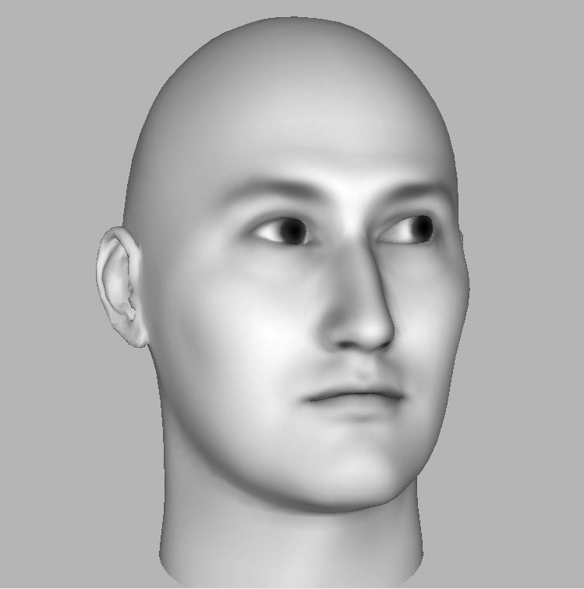
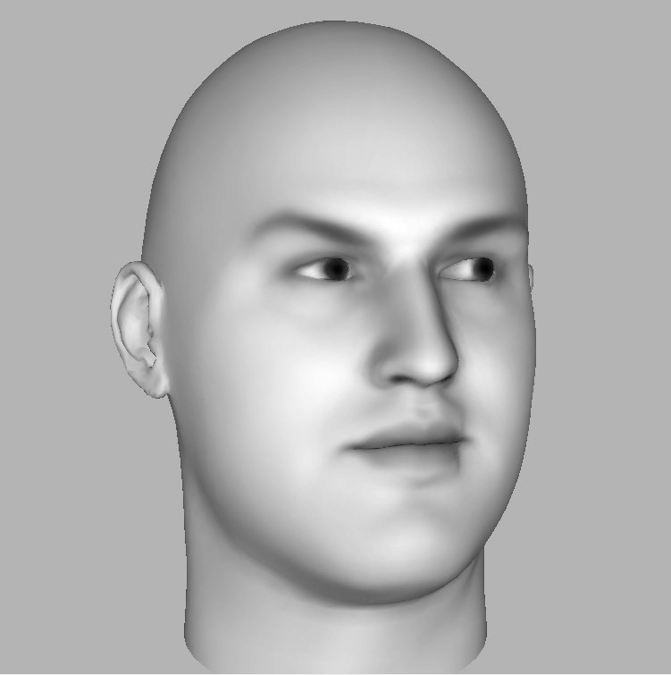
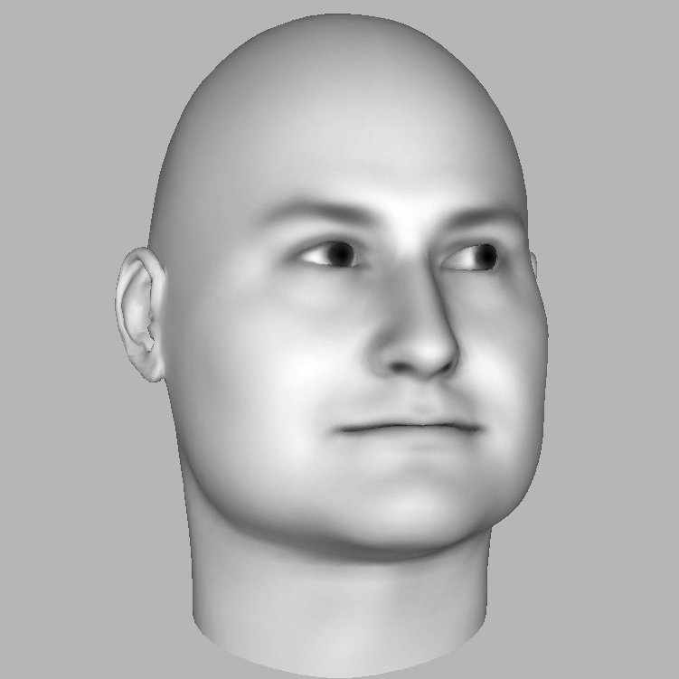
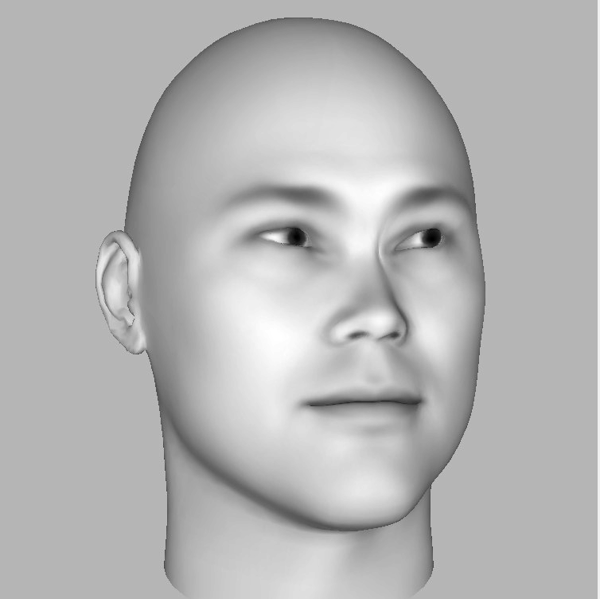
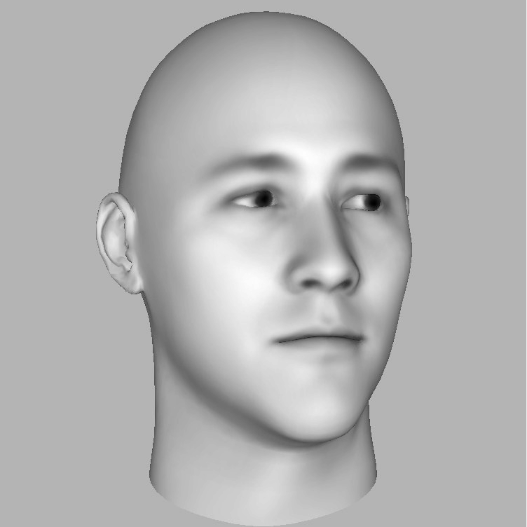
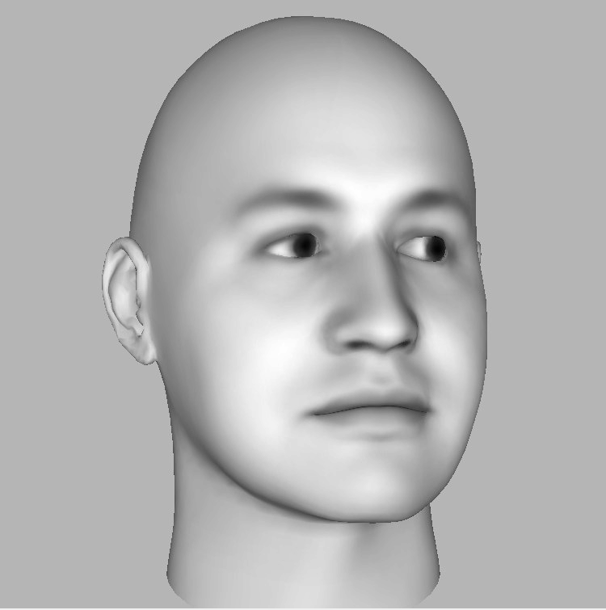
Experiment design:
After you start to run either the practice or experiment code, wait for a while for the images to be loaded.
A welcome text will be on the screen for both practice and experiment.
Experiment text e.g. ‘300 trials. Experiment: Wait 3secs to start’
You need to wait for 3 secs before the trial starts. Please make sure that you are looking at the middle of the screen. A fixation cross will show up after the 3secs pause.
After the fixation, a panel of faces in an arrow-like arrangement (e.g. on the right) will show up.
Your task is to identify the direction of the arrow (the global direction) as quickly and accurately as possible. You need to use left/right arrow key to indicate the direction for each trial.
The experiment is reaction time based.
After you clicked on an arrow key, you will move on to next trial.
E.g. The global direction if left
Correct response = press left arrow key

